Slide 1
Movement Preparation
Canadian Soccer Association
Sport for Life
Public Health Agency of Canada

Slide 2
Movement Preparation
A component of training to enhance performance and durability.

Slide 3

Physicalliteracy.ca
Notes:
Insert new guide cover here. And Link.

Slide 4
Movement Preparation
Objectives
enhance performance
enhance durability
Using well established scientific based principles of training the physiology and psychology of the player, and rooted in concept of physically literacy.

Slide 5

How is MP different than warm-up?
Initially, we used warm-up and cool-down approaches to prepare body for immediate action (game or training) – literally warming the body or “breaking a sweat” in the early years.
Then we progressed to dynamic warm up which really focused on prepping both the muscles (heart and skeletal) and brain for immediate action.
At this stage, the term “neuromuscular” training arose to recognize that preparation is both brain and muscle.
MP is a term which embodies both warm-up and dynamic warm-up concepts (brain and muscle training), but also adds the dimension of accumulating benefit. MP is not just for the immediate activity.
Warm-up
Dynamic Warm-up
Movement Preparation

Slide 6
Performance in Soccer
What are the key physical characteristics to develop in a player?
What are the key psychological characteristics of a player?
Take a moment to create a top three list for physical and for mental characteristics.

Slide 7
Performance in Soccer
Physical Characteristics
Speed & Acceleration
Aerobic fitness and endurance
Power
Agility
Spatial awareness
High motor proficiency in movement skills
Diverse movement repertoire
Symmetrical motor competence
… many others
Notes:
Rugged, strong, quick, etc

Slide 8
Performance in Soccer
Psychological Characteristics
Self or intrinsically motivated
Confident
Focused and determined
Able to manage emotions and anxiety
Goal setter and executes on plan
Punctual
Aware of people and environment
Commitment
Control over the outcome

Slide 9
Performance in Soccer
Is related to physical and mental characteristics.
BUT is also related to the ability of the player to “keep in the sport”, and this is where durability comes in.

Slide 10
Durability
“The ability to endure”
--- Ability to Participate ---
Endure training, endure in sport, and life
Includes both MENTAL and PHYSICAL characteristics
Is a positively framed concept
Is an inclusive term
  Fitness & exercise
  Physical literacy
  Motor control
  Biomechanics
  Nutrition
  Sleep, rest, recovery and regeneration
  Psychological
  Injury prevention
  Awareness and hazard detection
  Etc.

Slide 11
Physical literacy
A foundation for movement preparation

Slide 12
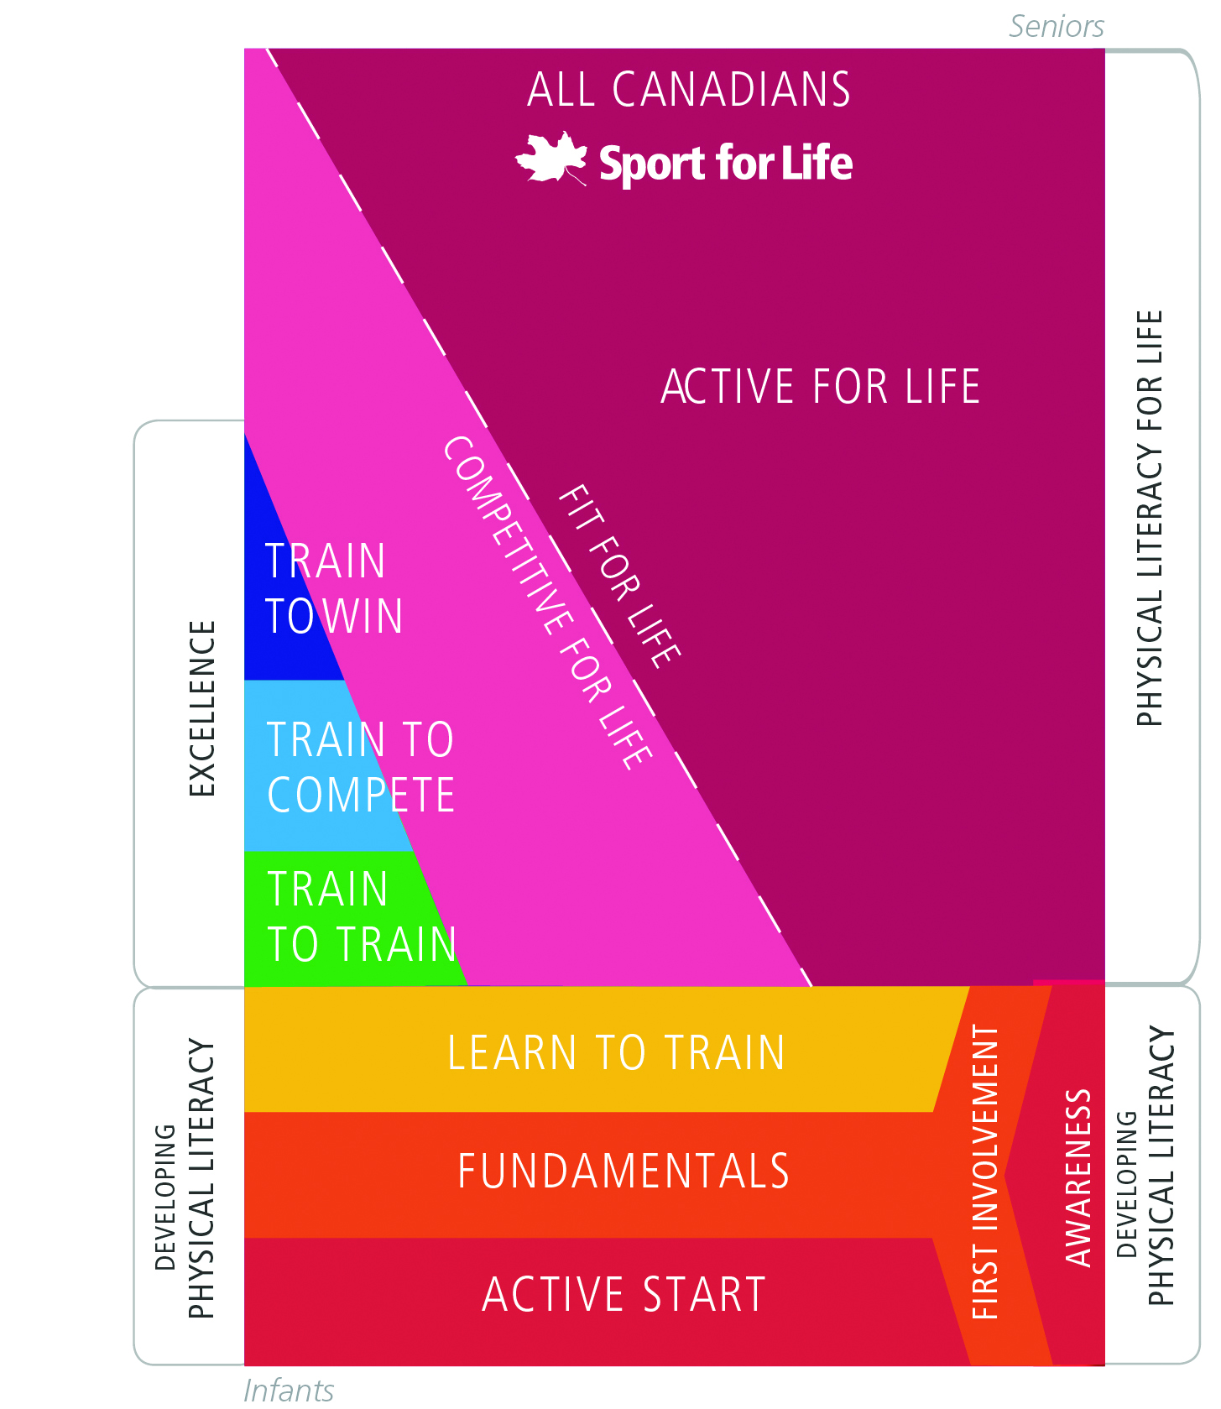
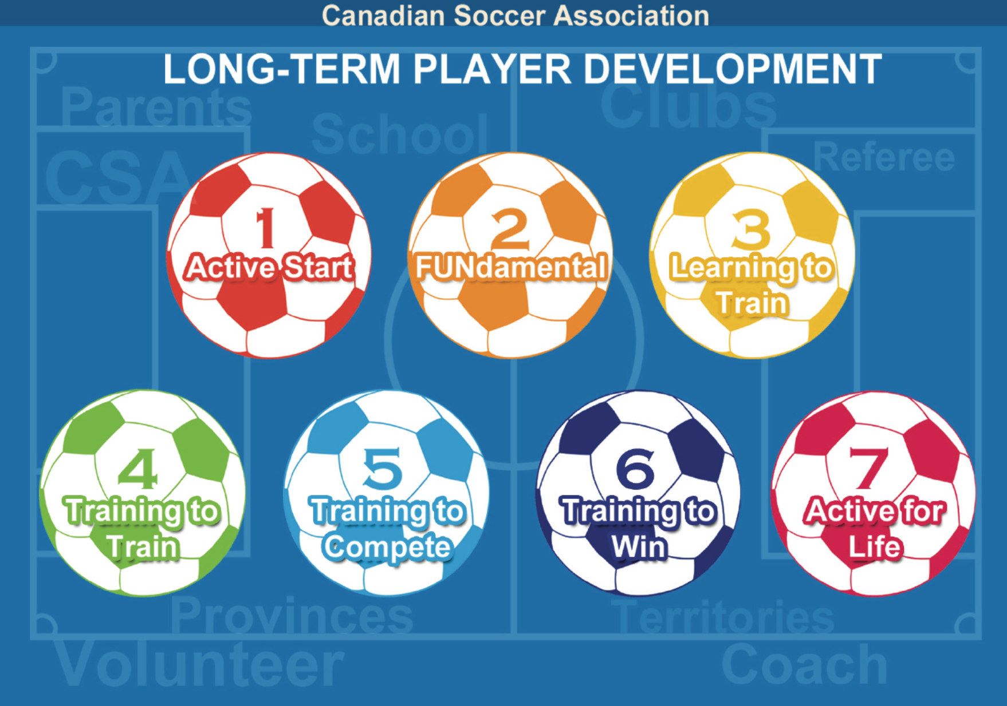
Movement Preparation & LTAD/LTPD
Movement Preparation and its component
parts can be utilized from ages 5 and up.
Movement preparation can be used from stages 1 to 7

Slide 14
Confidence
Motivation
Competence
Participation
Notes:
Modification of Liz taplin model

Slide 15
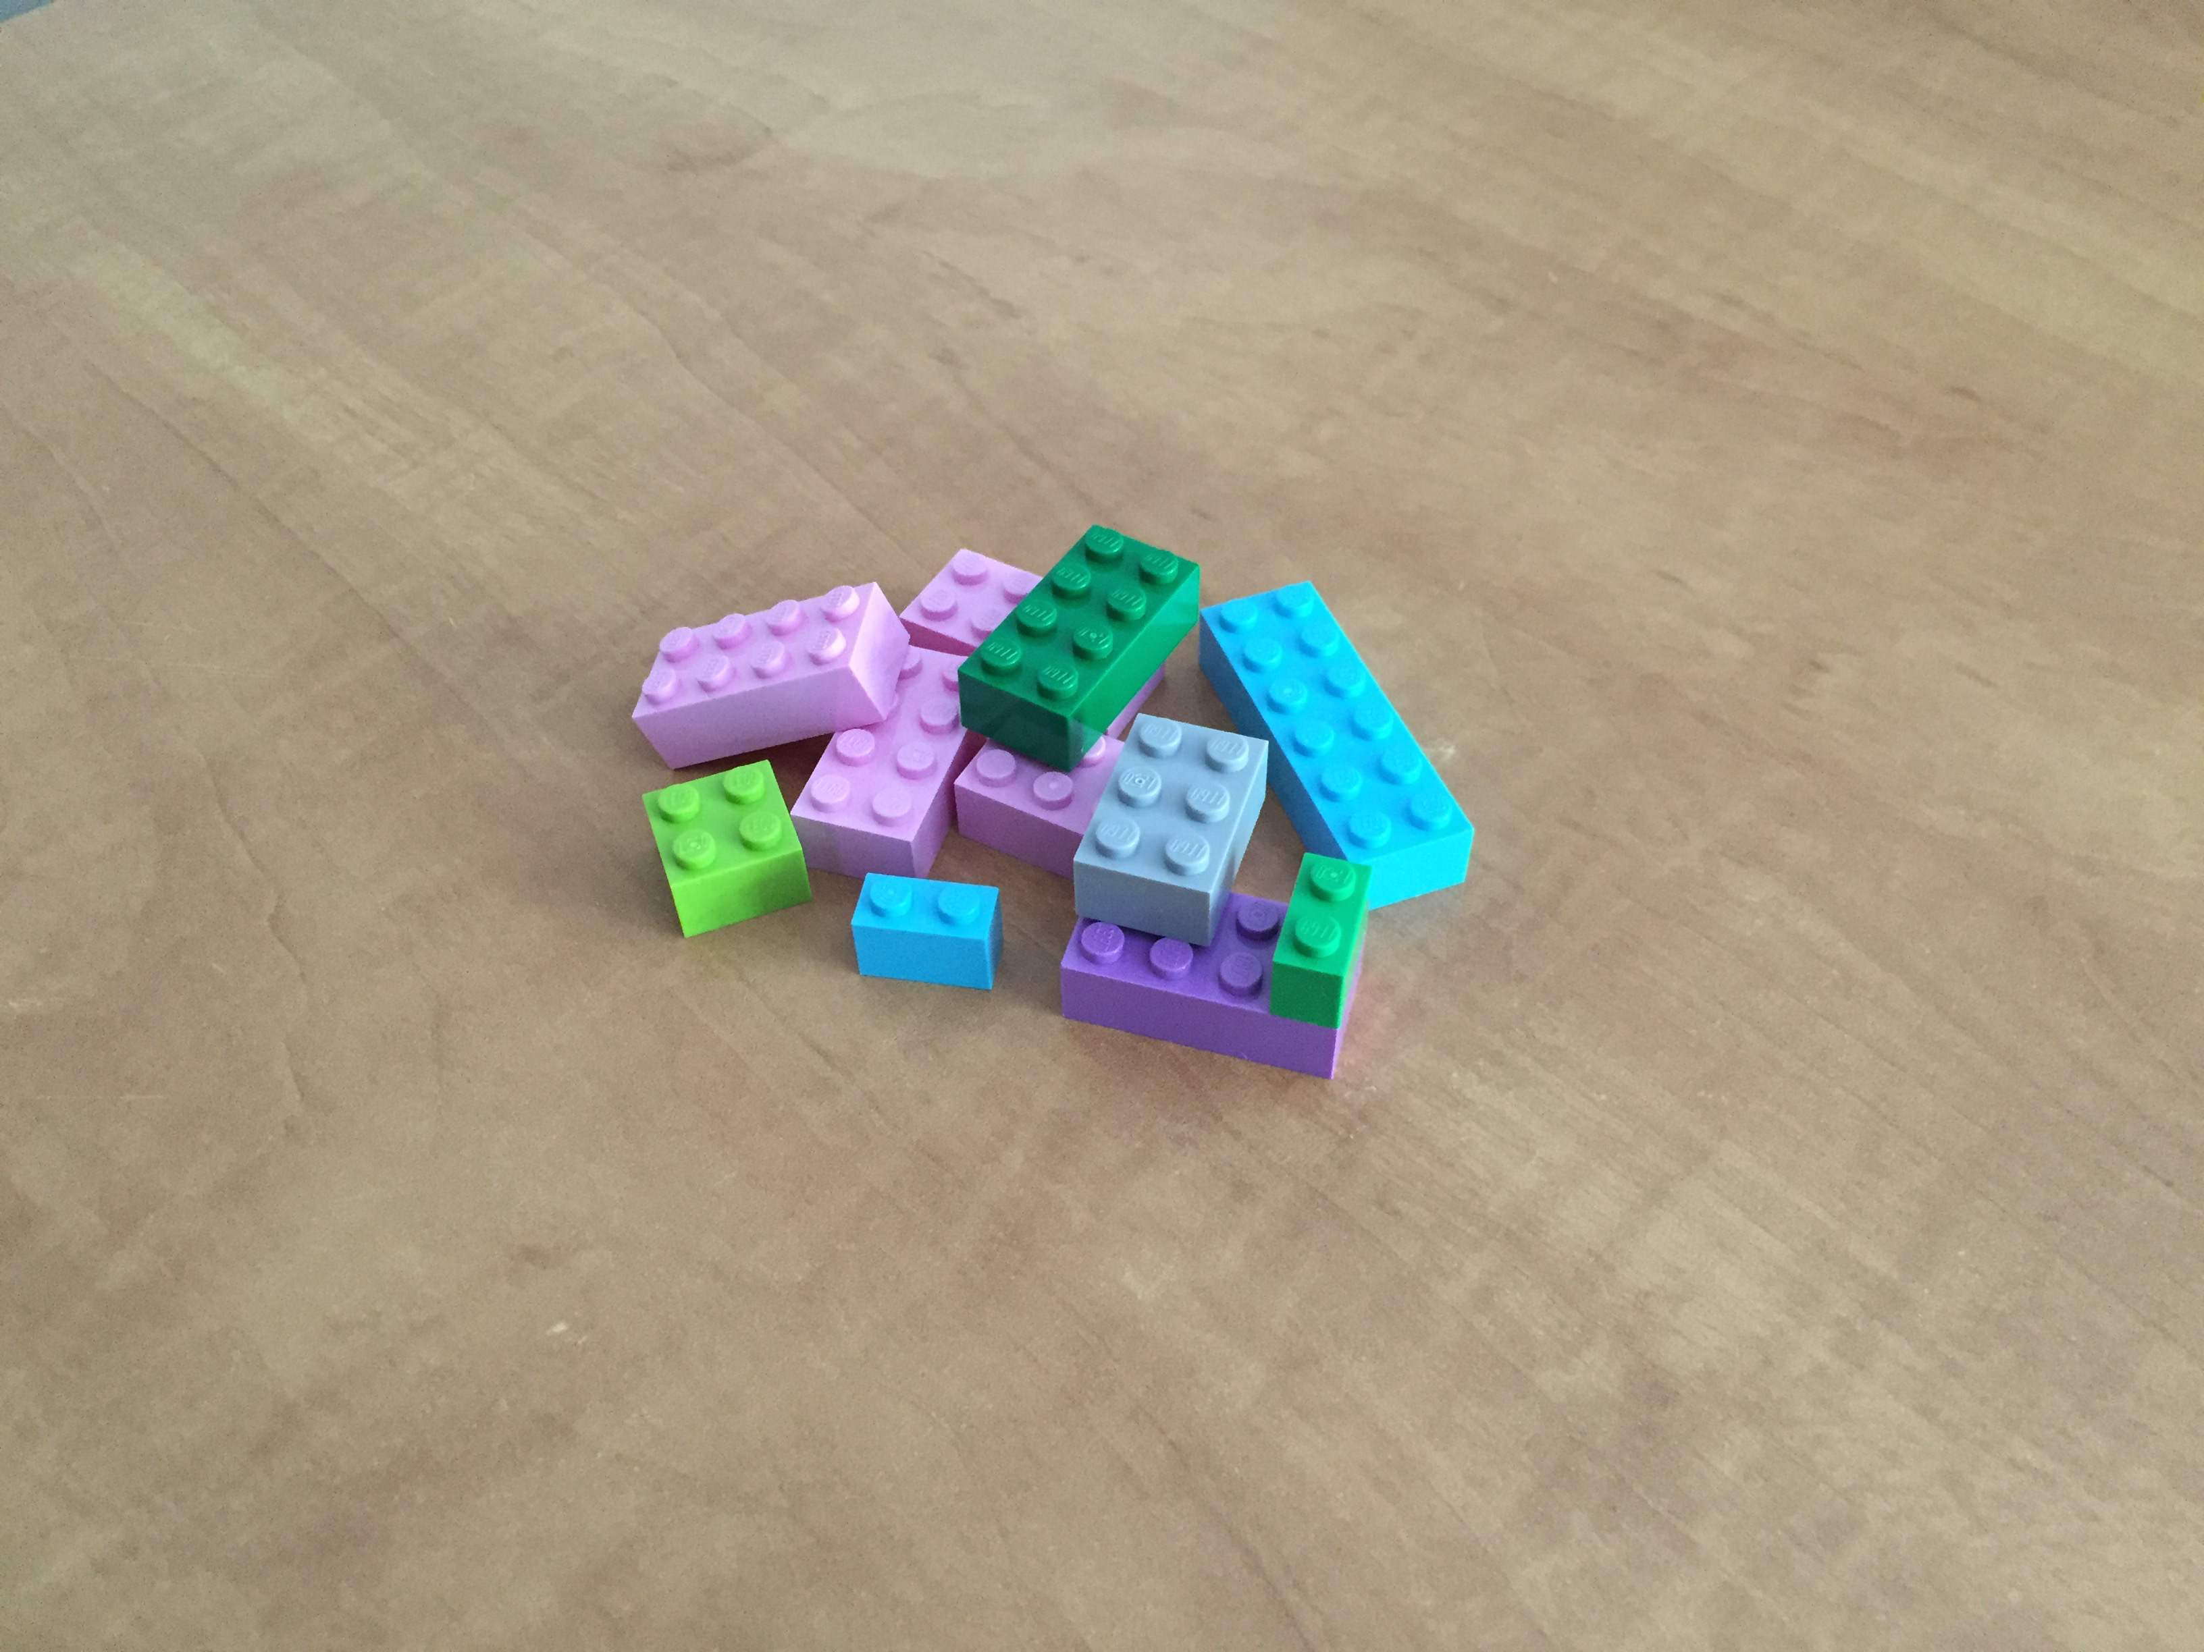
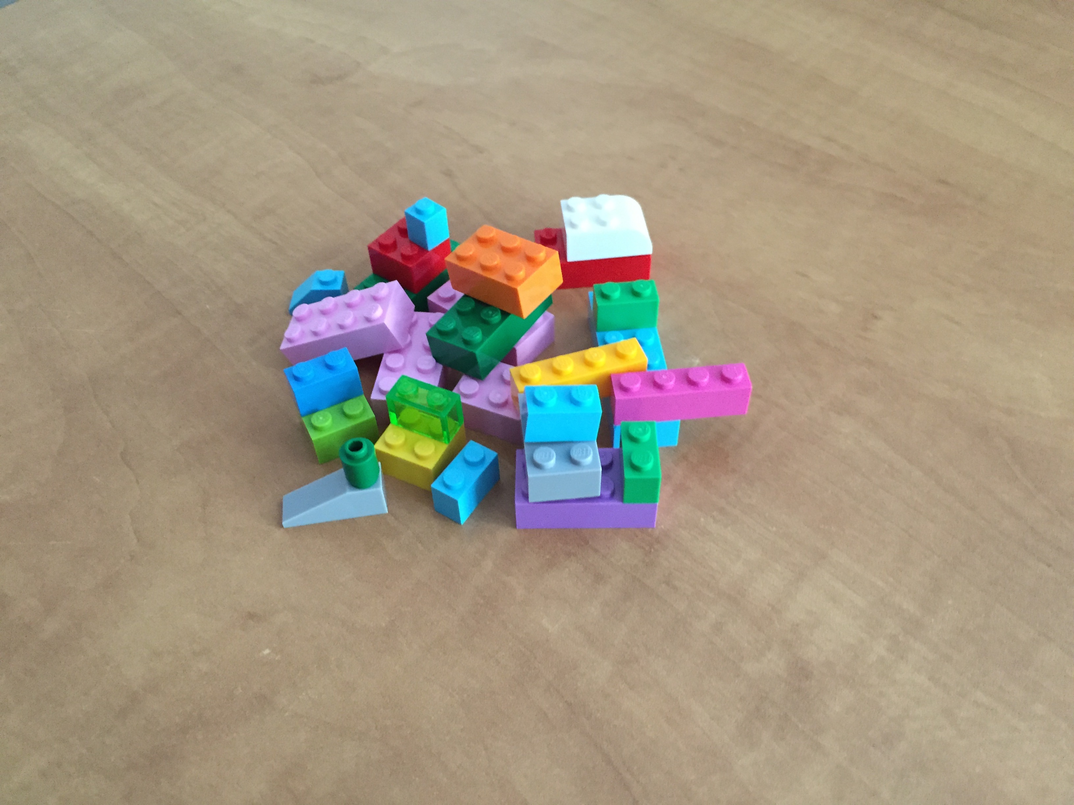
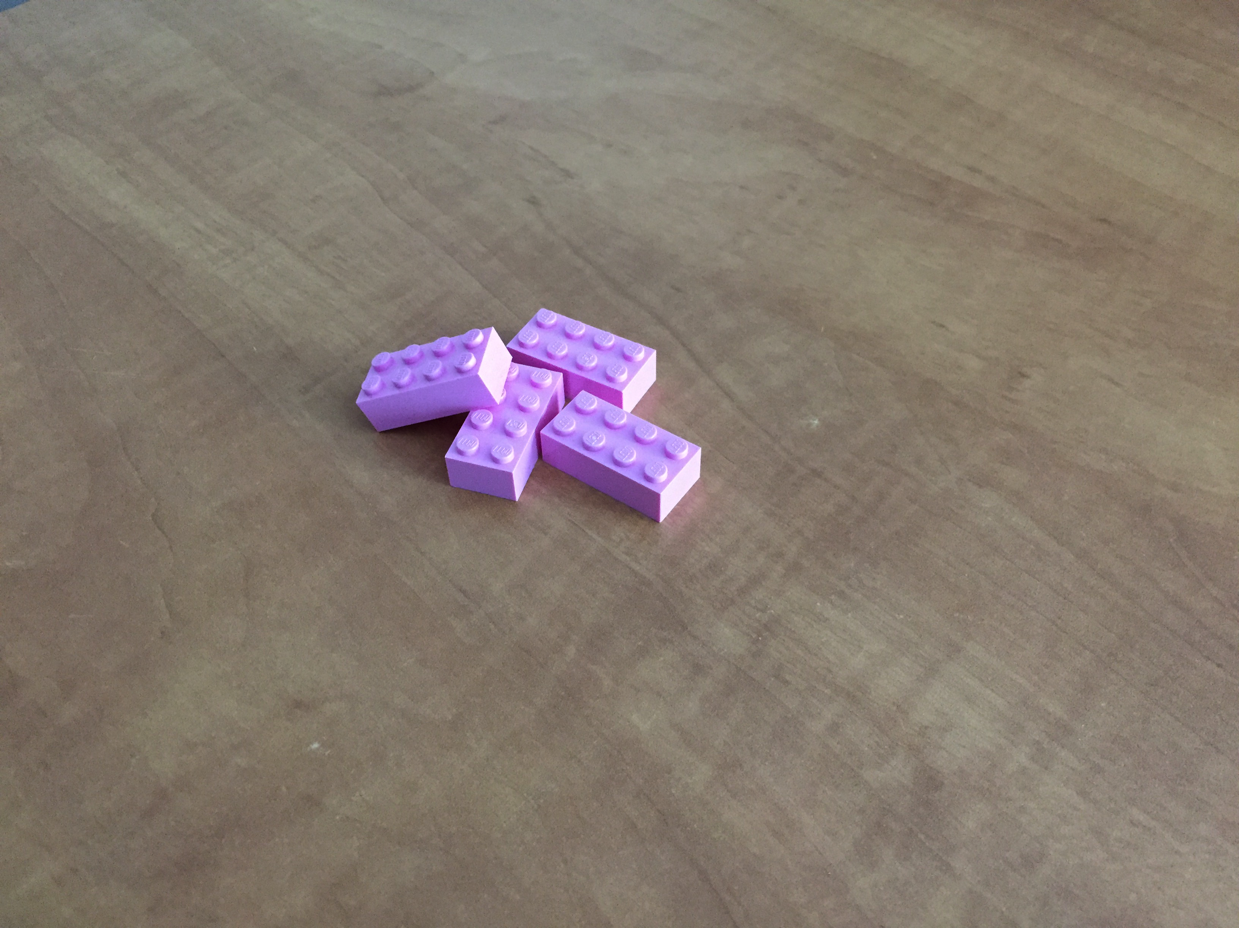
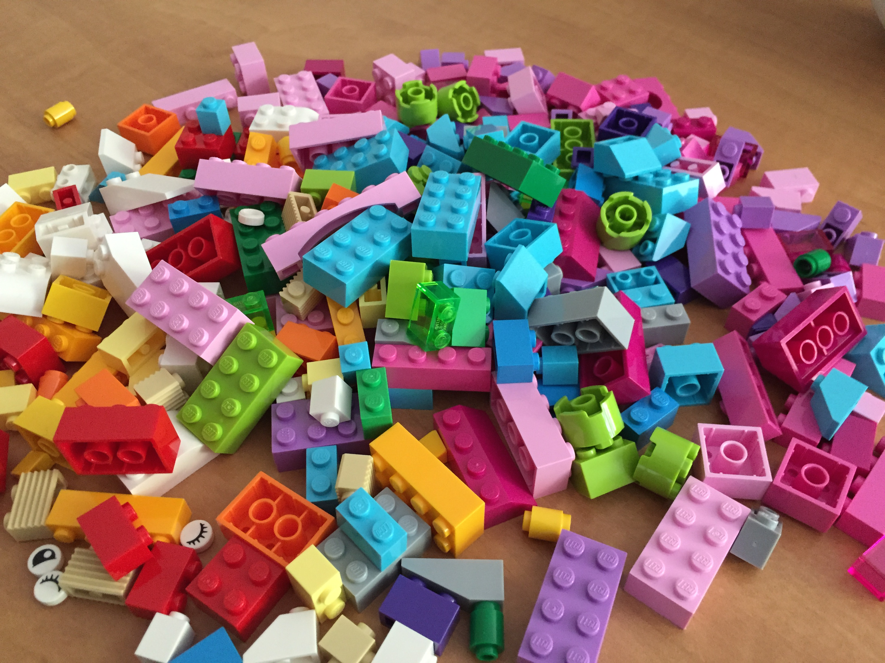
Movement Skills are the building blocks of Physical Literacy
GG
.
Notes:
Movement vocabulary = deep knowledge
Each block is a movement skill. Free play = learn to sequence works
Opportunity to explore = divergence
Create your own problems = convergence & ownership

Slide 16
Preparing for ALL Movements on the Field of Play
Motor control proficiency (ability to move well) improves with repetitions performed with knowledge of results (practice)
We purposefully practice numerous soccer specific skills that are performance related (kicks, headers, dribbling) but we often leave the other “obligatory” skills (cutting, collision avoidance, stumble recovery, etc.) to chance development.

Slide 17
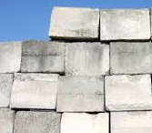
Movement Vocabulary
Awareness Selection Sequencing Modification
Environments (Physical and Social)
Physical Literacy
Comprehension Confidence Motivation
Free Play
Movement
Creativity
Motor Competence
Symmetry
Participation
Activity
Durability
Fitness

Slide 18
Quality Physical Literacy Experiences
Increase awareness (kinesthetic and spatial)
Increase competence in movement skills
Increase competence in sequence movement skills
Increase competence in modifying skills for circumstances
Increase the repertoire of movement skills
Decreased asymmetry from right to left
Increase competence in decision making in movement skill selection
Increase confidence
Increase motivation
Decrease social inhibition
Increase comprehension of movement terms
Lead to increased participation leading to increased fitness and performance
Lead to increased participation leading to improved mental and physical health
PLUS if you deliver PL you can achieve fitness

Slide 19
Movement PREPARATION BASICS

Slide 20
Movement Preparation
Designed to be implemented in relatively small active space from gym to outdoor field
Designed to use readily accessible materials (cones and ladders)
Designed to be developmentally progressive to maximize personal excellence and performance excellence
Ages from 7 & up, components down to 5 years old

Slide 21
Entry Level Implementation
At younger ages (5-9), and entry level situations ay any age we always implement MP in a fun, social, and semi-structured manner
We start with selected components of the entire MP each session, and add in components progressively over time
  Children and adults love to master new skills when presented in this manner
  Of course, at any age, fun and challenge are key components to successful training

Slide 22
Movement Preparation Components
Dynamics
  Basically a dynamic warm-up
Accelerations
  Improve speed and acceleration from both feet
Cutting
  Enhance cutting proficiency and symmetry
Ladders
  Enhance footwork proficiency and symmetry
Core
  Provide a dynamically stable core for lower and upper limb movements
ALL components contribute to sport related fitness development

Slide 23
EQUIPMENT and RESOURCES

Slide 24
EQUIPMENT & RESOURCES
Equipment
  32 to 40 cones (compressible)
  1 to 2 full ladders which can break down in half
Resources
  Movement Preparation Interactive PDF (iPDF)
  Movement Preparation web materials

Slide 25
Field SETUP

Slide 26
Dynamics & Accelerations
Ladders
Core
Cutting
Equipment
32 cones
1-2 full length ladders

Slide 27
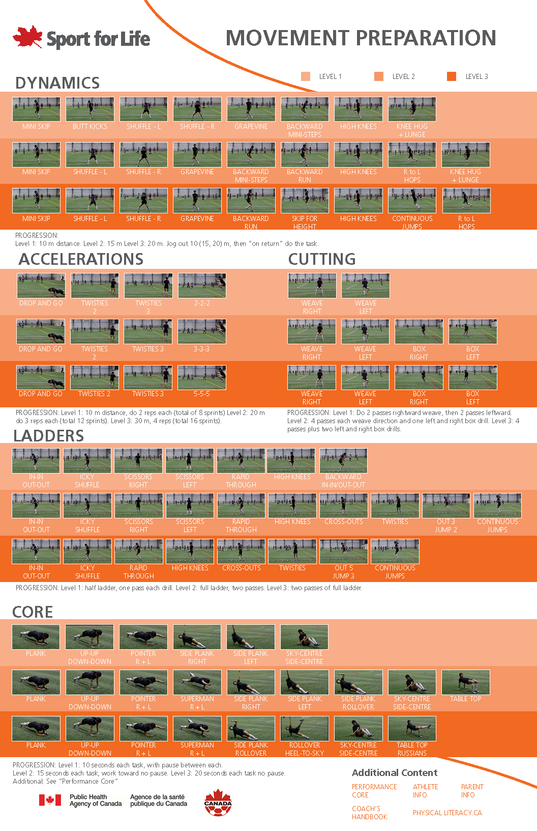
MP Interactive PDF
Short video
Color Coded Levels 1,2,3
Basic progression info
for each component
Each Component title
is a link to an annotated
PPT file (cues, why, etc.)
Links to PDFs:
Coach’s Handbook
Athlete Info
Parent Info
Physicalliteracy.ca

Slide 28
Movement Preparation iPDF
“Portable Instruction Manual”
MP iPDF shows the three MP progression levels with pictures and videos
MP iPDF can print as a tabloid poster
MP iPDF is platform independent but needs cellular or wireless connection
MP iPDF has links to
  Coach’s Handbook, Athlete Info, & Parent Info
    Are iPDFs as well
  Annotated PPT of each MP component
    Dynamics, Accelerations, Cutting, Ladders and Core
    Provides Cueing and Rationale for each element

Slide 29
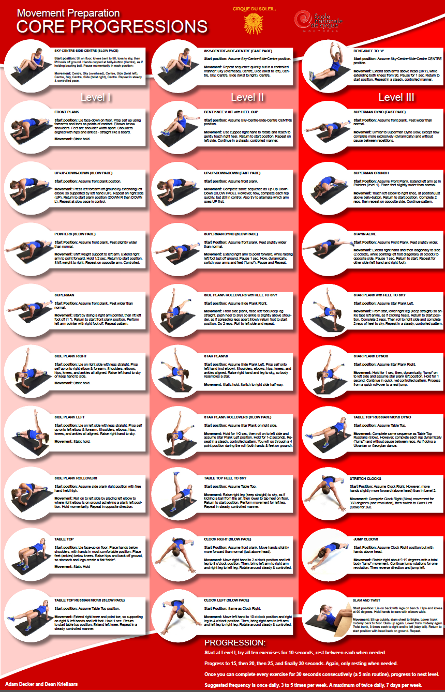
MP: Performance Core

Slide 30
MOVEMENT PREPARATION COMPONENTS

Slide 31
Movement Preparation Components
Dynamics
Accelerations
Cutting
Ladders
Core

Slide 32
BASIC PROGRESSION
Don’t start with the entire movement preparation, especially at younger ages.
Intro with dynamics
Intro with core
Then add a MP component each session

Slide 33
DYNAMICS

Slide 34
Dynamics Elements
mini skip
butt kicks
side shuffle right
side shuffle left
grapevine
backward mini steps
fast backward run
moderate skip for height
high knees continuous
jumps
right to left hops
knee hug and lunge

Slide 35
Dynamics
Key Objectives
  To develop motor competence in forward and backward footwork
  To develop dynamic balance
  To develop spatial awareness
  To develop lower body strength and power
  To develop aerobic fitness

Slide 36

Line Dynamics
10, 15, 20 m
mini skip
butt kicks
side shuffle right
side shuffle left
grapevine
backward mini steps
fast backward run
moderate skip for height
high knees continuous
jumps
right to left hops
knee hug and lunge
Team lines up here
Jog out as team
“jog out”
Return doing activity
“skip back”
Level 1 – 8 activities, total distance 8x2x10 = 160 m
Level 2 – 9 activities, total distance 9x2x15 = 270 m
Level 3 – 9 activities, total distance 9x2x20 = 360 m

Slide 37
Circular Dynamics
Team forms two lines
mini skip
butt kicks
side shuffle right
side shuffle left
grapevine
backward mini steps
fast backward run
moderate skip for height
high knees continuous
jumps
right to left hops
knee hug and lunge
Do activity back
Jog
Do activity back

Slide 38
ACCELERATIONS

Slide 39
Accelerations
Elements
Drop and Go
Twisties 2
Twisties 3
222, 333, 555

Slide 40
Accelerations
Key Objectives
  To develop sprint performance through improved acceleration and top speed
  Develop running form
  Develop lower body power
  Develop ability to start from right or left stance
  Develop the ability to start from an unstable position
  Develop short term energy systems

Slide 41
Accelerations
10, 20, 30 m
Team lines up here
Drop and Go
unbalanced start
Twisties 2
Start of one foot back
Twisties 3
Start of the other foot back
2,2,2 | 3,3,3 | 5,5,5
Fitness and start from
unbalanced position
Drop & Go
Twisties 2
Twisties 3
222, 333, 555
Accelerate to half way (dotted line)
and slow down to pylons, jog back
Level 1 – 10 m by 2 reps of each task, 8 sprints total, 80 m
Level 2 – 20 m by 3 reps of each task, 12 sprints total, 240 m
Level 3 – 30 m by 4 reps of each task, 16 sprints total, 480 m

Slide 42
LADDERS

Slide 43
Ladders
Elements
in-in-out-out
icky shuffle
scissors right
scissors left
rapid thru
high knees
cross outs
twisties
out 3 jump 2
out 5 jump 3
continuous jumps
backward in-in-out-out

Slide 44
Ladders
Key Objectives
  To develop motor competence in footwork
  To develop dynamic balance
  To develop spatial awareness
  To develop movement sequences
  To develop lower body strength and power

Slide 45
Ladders
2nd Person
Start Point
Team equally distributed
between ladders
Start
Line 1
Return
Start
Line 2
Start
Line 3
Notes:
Avoid a single line to minimize peer pressure and use a no consequence pylon for starts

Slide 46
CUTTING

Slide 47
Cutting
Weave right
Weave left
Box left
Box right

Slide 48
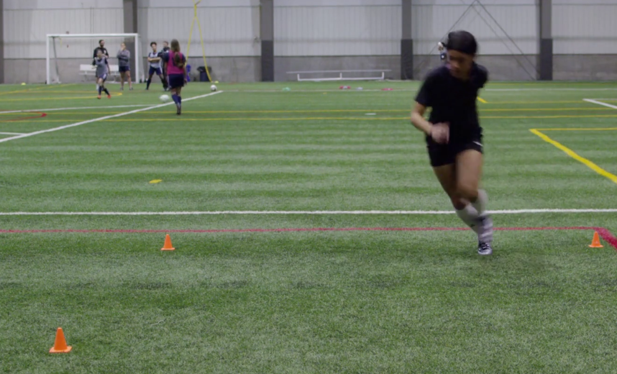
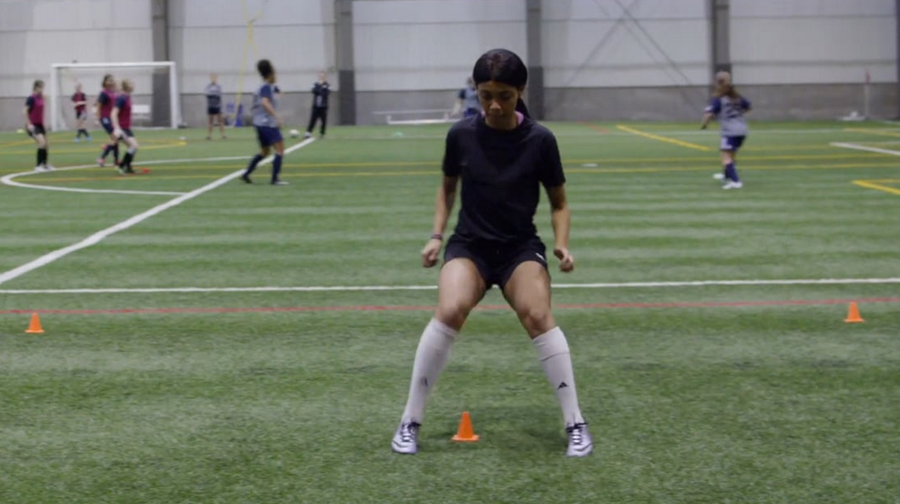
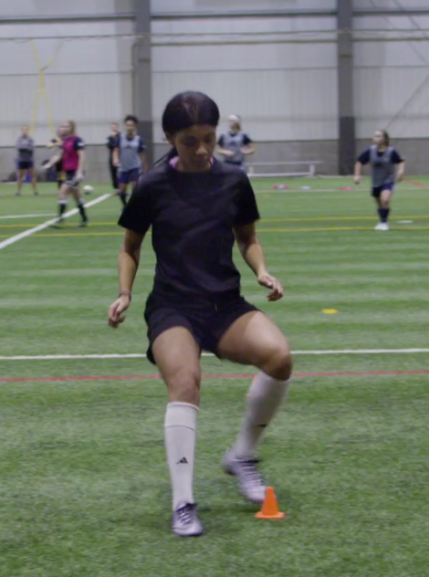
Cutting Objectives
Develop motor competence in change of direction from R to L, L to R for forward, diagonal and backward directions
Reduce asymmetry in movement proficiency
  Higher level of performance
  Lower injury risk

Slide 49
CUTTING- WEAVEs

Slide 50
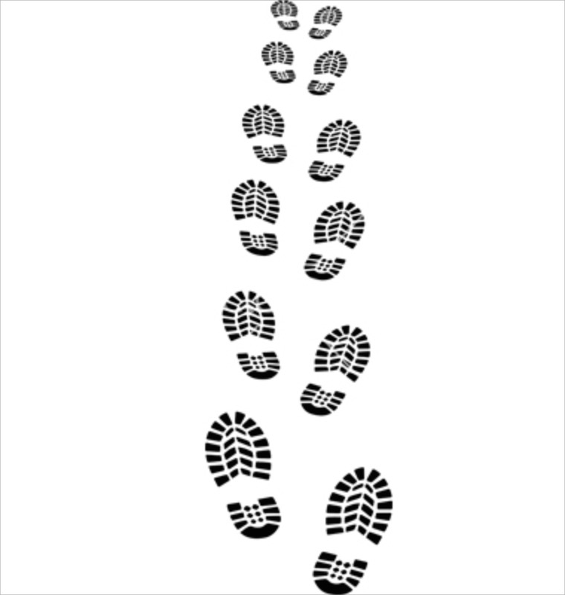
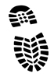
Weave
Speed
Progression
50%
60%
70%
80%
90%
100%
Pressure
Progression
Contact
Progression
Line Here
Plant Plant
½ Box Cut
Weave Left

Slide 51
Basic Progression
Start at slow to medium speed
  Not unrealistically slow
Stand just back from first pylon and use “Plant Plant“ verbal cueing
When shown, ask them not to “stutter step in” as it telegraphs change of direction
As they become automatic at that speed (forward to backward and backward to forward) then progress speed

Slide 52
Progression Parameters
Speed
  Slow/medium to performance speed
Directions
  All change of direction maneuvers ideally (drills do not cover all)
  Single leg landing partially covered
  Adaptation of drills
Pressure
  No pressure to encroaching “no contact” presence
Contact and Avoidance
  Contact, push-off, and avoiding contact
Surface Progressions
  Gym floor, grass, artificial, sand
Footwear Progressions
  Runners to cleats
Competition or Rivalry
  In a mini-weave drill add a side by side cutting course

Slide 53
Progression
Speed progression
  slow/medium to medium to faster to performance speed
Pressure progression
  Starting with you standing at pylon (medium pace)
  Advance to pylon “encroach slightly into space”
  Have them become automatic with the near collision and footwork will change

Slide 54
Progression
Surface progression
  Cutting on each type of surface requires different neuro-mechanically characteristics
  Being able to cut on a gym floor does not adequately prepare for fluid and controlled movement on artificial turf or grass
Footwear progression
  It takes many repetitions to learn to cut in runners, and an adequate number of repetitions should be performed on the artificial or grass surface with cleats

Slide 55
Progression
Contact Progression
  Add a hand to hand contact to cut
  Add a hand to hand push off
  Add a shoulder check
  Add a gentle push

Slide 56
Learning Moments
Stutter step
Control
  Fluid and automatic decelerating plant controlling speed entering plant
  Fluid weight transfer to opposite foot
  Fluid and definitive acceleration in opposite direction
Difference in cut from L to R and R to L
Difference in ability to shift forward to back versus backward to forward
How presence of another impacts movement quality

Slide 57
CUTTING – BOX

Slide 58
Box Right
Start
Touch EVERY Pylon
Forward and Back
Diagonal and Back
Side and Back

Slide 59
Box Left
Start
Touch EVERY Pylon
Forward and Back
Diagonal and Back
Side and Back

Slide 60
CORE

Slide 61
Core
plank
up-up-down-down
pointer right and left
superman right and left
side plank right
side plank left
side plank roll over
side plank roller over heel to sky
bent knee V sit "sky centre side"
table top
table top russians

Slide 62
Core Objectives
Traditional Core
  Develop strength of muscles
  Develop endurance of muscles
PL Enriched CORE
  Develop multi-planar stability (must control movement in all directions)
  Develop multi-segmental stability
    Stability does not mean static, dynamic stability is VERY NB
  Develop perturbation management for expected and unexpected circumstances
  Develop distal segment load control (control limb motion)
  Develop inter-segmental buffering (use interposed joints to buffer load)

Slide 63
CORE
Can be performed in two lines or a circle
Typically a designated player or parent or coach lead the session
The lead cues each component and sets duration

Slide 64
On Field
Demo each component of MP
  Dynamics, Accelerations, Ladders, Cutting, Core
Create groups of 4 and have each group run through each of the components
Wrap up with Q&A

Slide 65
LF BACKGROUND SLIDES

Slide 66
The Need
A systematic approach to develop physical literacy, fitness and positive psychology for personal excellence and performance excellence.
  Combat against physical inactivity and free play
  Keep kids in the sport
  Compensate for lack of optimal development in motor skills
  Reduce the gender gap in motor competence
  Contribute to reduction in lowering injuries

Slide 67
LF BACKGROUND SECTIONS
Developing physical literacy in youth
Motor competence
Quality Sport Experience in soccer can fix the motor competence problem using LTAD
Limb dominance
ACL injury information
Motor control errors
Creating quality training sessions
Movement preparation program evaluation study
Gluteus Medius to the Maximus (MP +)

Slide 68
Developing physical literacy in youth

Slide 69
The Physical Literacy Cycle
Develop movement competence
Create environment where each participant can be challenged to their own level of ability in a fun and social setting
Child realizes that failure is part of success not the opposite of success
Leads to confidence
Leads to enjoyment of activity and socialization leading to motivation to continue participation
Leads to child feeling comfortable moving in front of others especially when an audience is present
Leads to child self-identifying that they possess talent, and that talent is not winning but mastery of movement

Slide 70
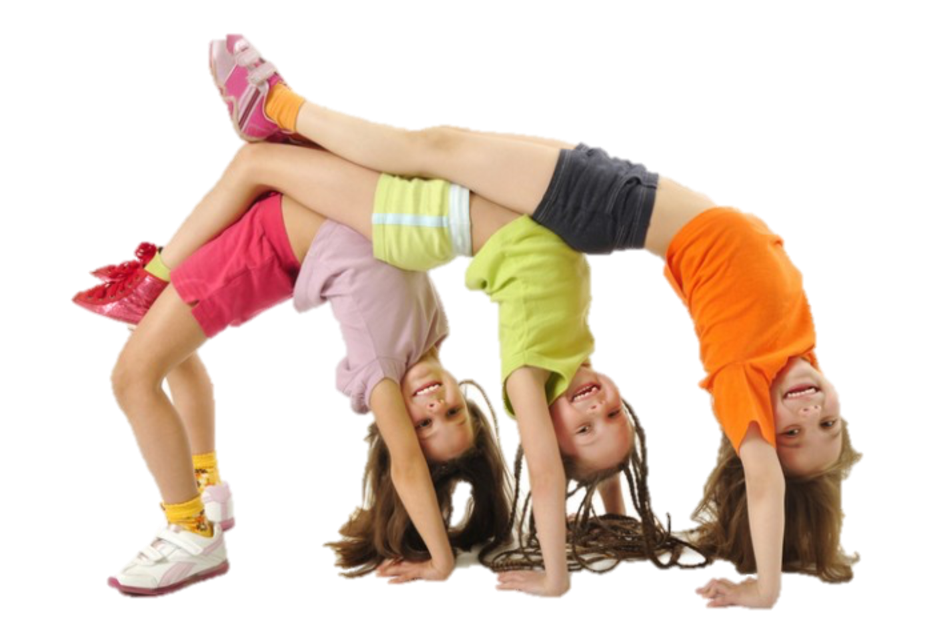
Challenge
Successes
Confidence
Motivation
Competence
Participation
FUN
Failures
Audience
Talent
Notes:
Modification of Liz taplin model

Slide 71
Motor Development STUNTED In an inactive no play world

Slide 72
Quality
Physical Literacy
Expereince
Confidence
Motivation
Competence
Participation

Slide 73
Deficits in Motor competence

Slide 74
Participation

Slide 75
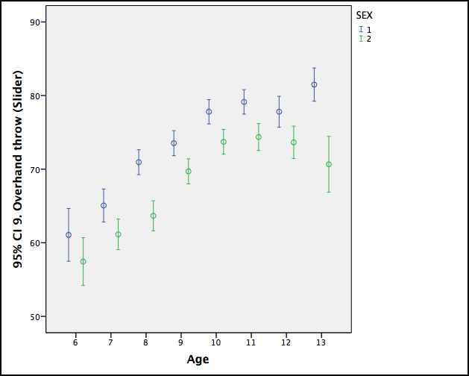
Boys, n=2938
Girls, n=2835
Curricular Expectation
Overhand Throw (Proficiency, mean 95% CI)
My Personal Best, 2014
Notes:
lg gender gap
Don’t deliver on current PE expectations
*different scaling was used (~25mm higher than IMPACT)
By age 8-9, expect kids to be at 50 mm (80 mm on this scale) to be competent at the skill
Intervention: trained ppl and made aware of the problem level in kids (added PL enriched enviro & prgming)….from this there was a large change noted

Slide 76
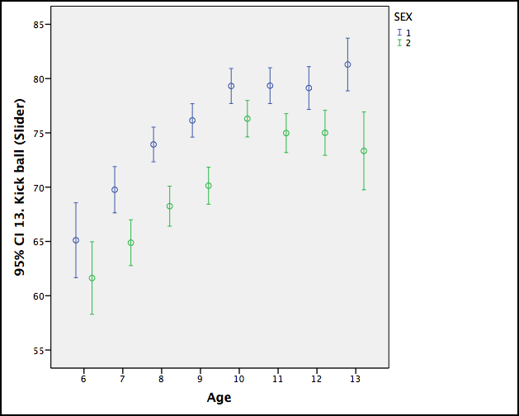
Boys, n=2938
Girls, n=2835
Curricular Expectation
Kick a ball (Proficiency, mean 95% CI)
My Personal Best, 2014
Notes:
268 after school pgms in ON
Trained ~400 people in: 1) FMS 2) Hi-Five (child mngt pgm- Cdn Parks & Rec) 3) PL 4) PLAY Fun & Self
**Pgm Evaluation (no control grp)

Slide 77
Deficits in MOVEMENT VOCABULARY

Slide 78
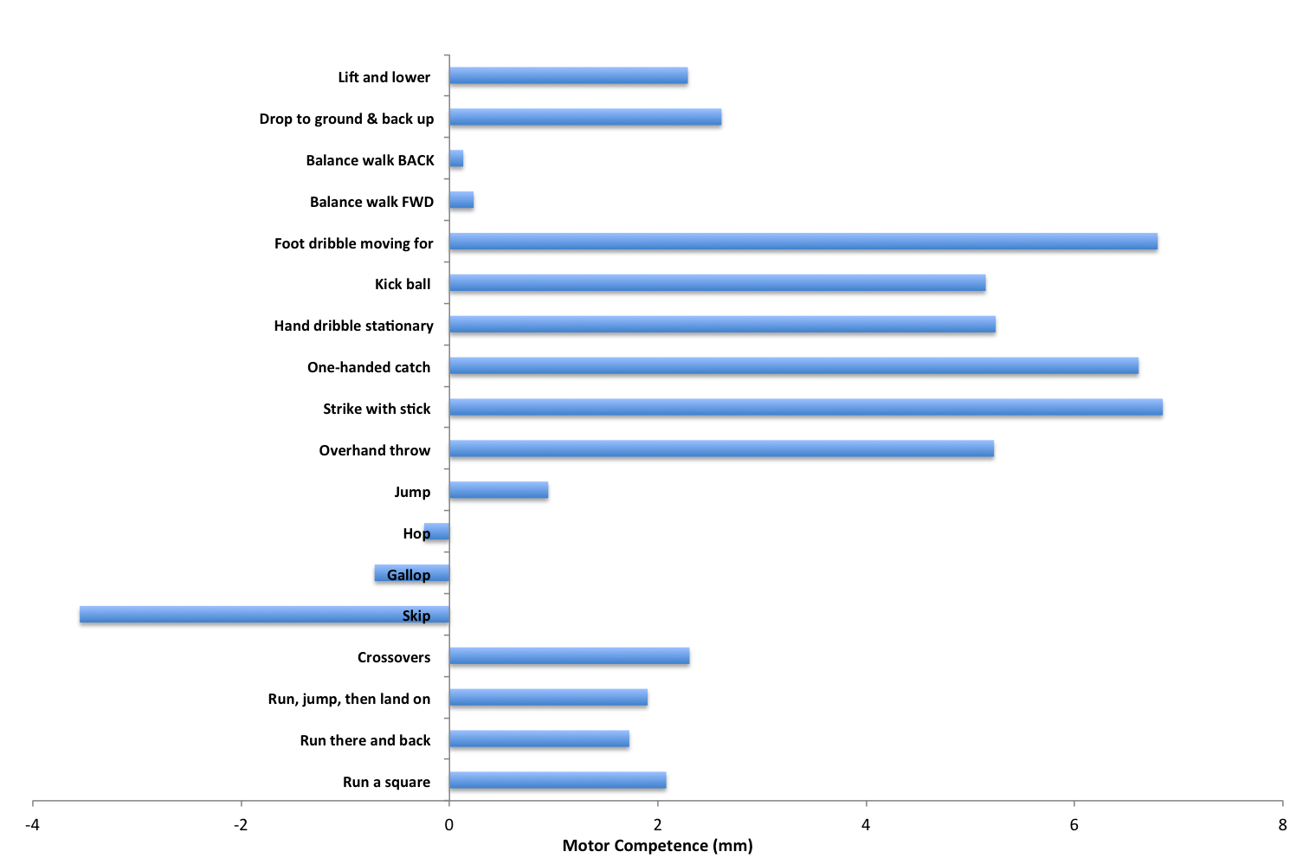
Motor Competence in Curricular Linked Skills
(n=5773, My Personal Best, 2014)
Female > Male
Male > Female
Notes:
Time on task – culture does not provide to girls –
PLAY Fun: difference of 4mm on 100mm scale is detectable as a visual difference (ex. Skipping)

Slide 79
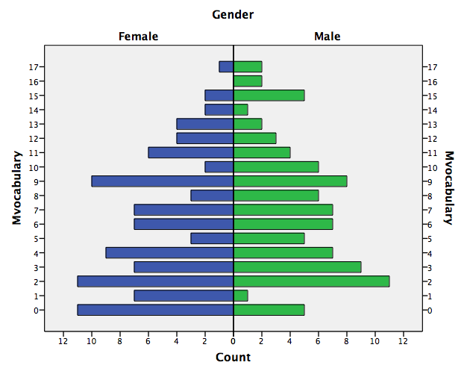
Movement Vocabulary

Slide 80
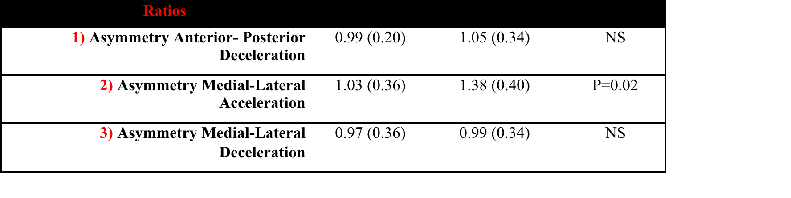
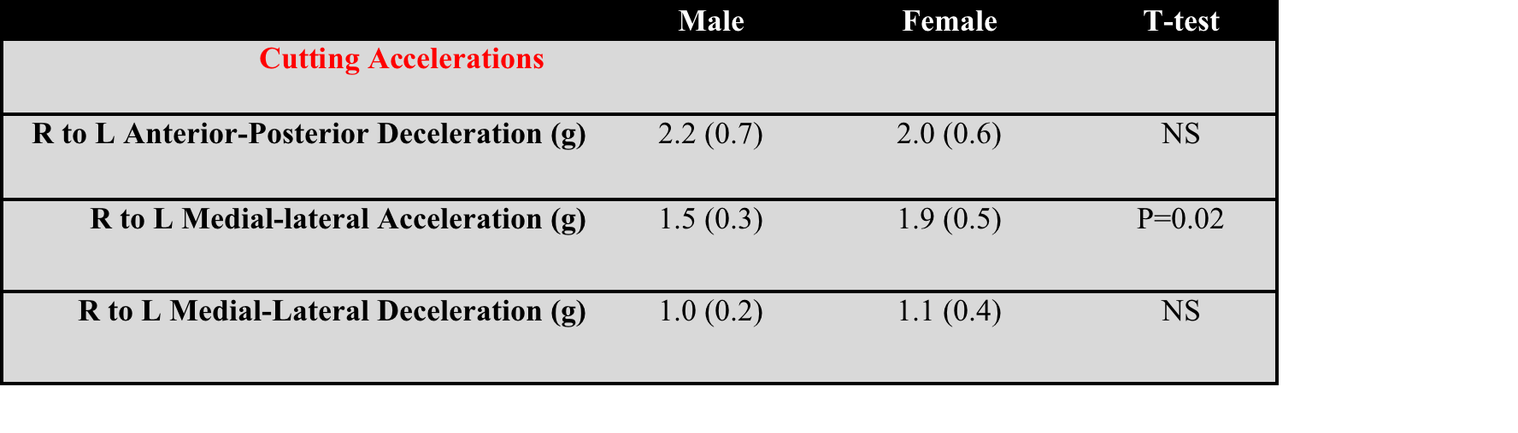
Females Cut Different & Asymmetrically

Slide 81
Deficits in MOVEMENT CONFIDENCE

Slide 82
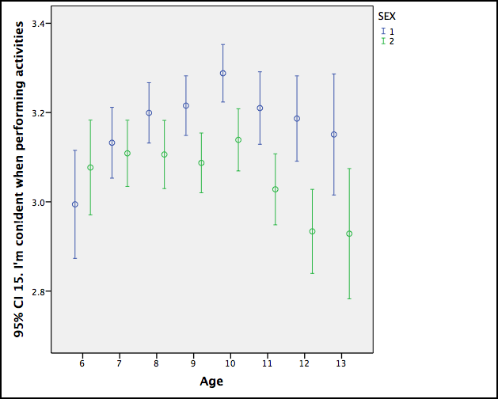
Confidence in Performing Activity
(My Personal Best, 2014)
Boys, n=2938
Girls, n=2835
Confidence in activity (mean 95% CI)
Notes:
Confidence gap created at 8 to 9 years old when competence separates (last slide)

Slide 83
Quality
Physical Literacy
Expereince
Confidence
Motivation
Competence
Participation

Slide 84
Deficits in HAPPINESS and motivation

Slide 85
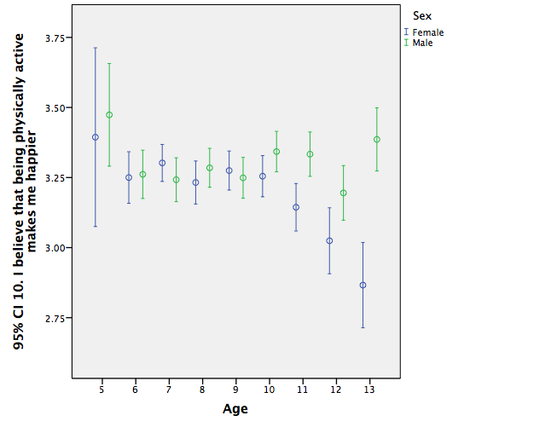
Happiness and PA

Slide 86
Quality
Physical Literacy
Expereince
Confidence
Motivation
Competence
Participation

Slide 87
QUALITY COACHING delivering QPLE

Slide 88
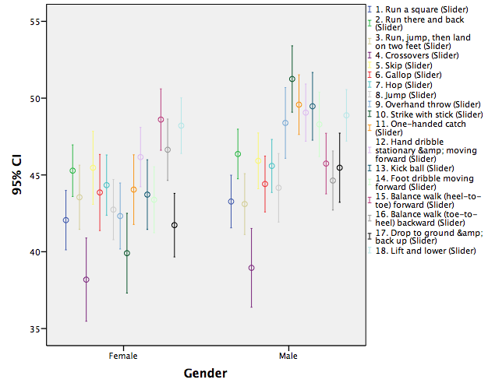

Slide 89
Motor Competence in Grade 3
Females lag behind boys in most movement skills in standard system
Neither boys nor girls are achieving desired competence in basic movement skills the standard for this age is a score of 50

Slide 90
Motor Competence in Grade 3
In the next slide, quality sport experiences delivered by coaches that employ LTAD with physical literacy as the foundation (and using MP) achieve, in a mix of boys and girls, the desired movement competency (greater tan 50!
So it can be accomplished!

Slide 91
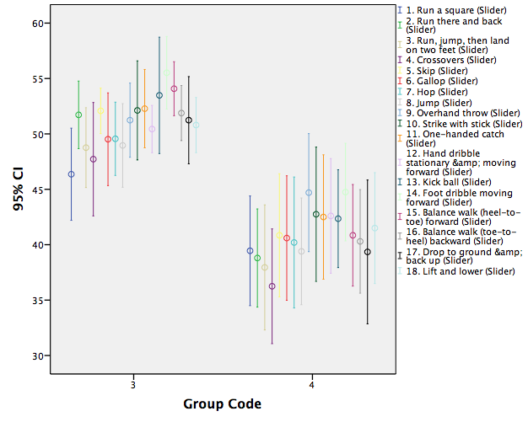
Dev Soccer
Rec Soccer

Slide 92
Limb Dominance

Slide 93
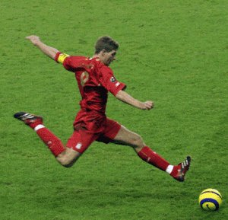
It’s all about the “manipulation” foot, right?
Exquisite targeting is required for the plant leg, otherwise bad kick and injury possibility.

Slide 94
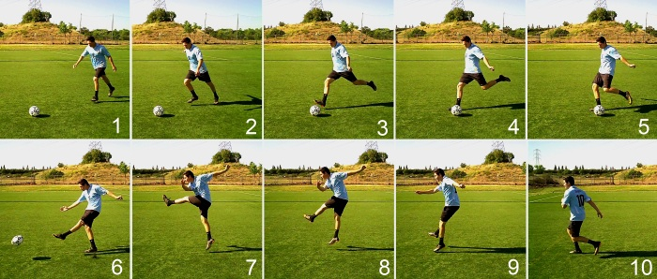
2) L - STABILITY
1) L - MANIP
3) R - MANIP
THE KICK
4) R - STABILITY

Slide 95
Limb Dominance
It is a fallacy that the limb opposite to the primary kicking leg is the stability dominant leg!
BOTH right and left lower limbs need to target foot planting, as illustrated.
BOTH right and left lower limbs need to be good stabilizers. In fact, 65% of the time the best stability leg is the primary kicking leg.
Training is required for both limbs in each capacity (stabilizer and manipulation).

Slide 96
Acl Injury BACKGROUND

Slide 97
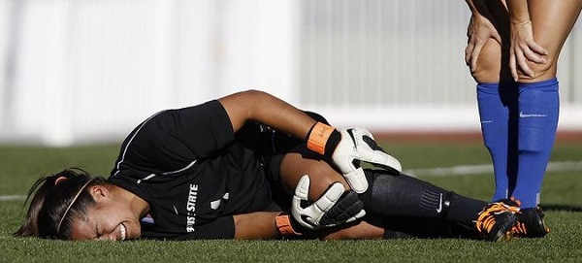
ACL injury
http://rebuildingchampions.com/acl-injuries-common-among-athletes-2/
Young female soccer players are at 4-6 x greater risk of ACL injury than their male counterparts (Filipa et al., 2010; Hewett et al., 2010).
In non-contact ACL ruptures,:
  females are more than twice as likely to injure the ACL of their non-dominant side as their dominant side
  2-3 times more likely to injure their non-dominant side ACL than are males (Brophy et al., 2010)
Males show no significant relationship between lower limb dominance and ACL injury in non-contact incidents
Notes:
The rationale for the very high ACL injury rate on the non-dominant side in females in non-contact incidents has not been established, but could relate to sex differences in differential manipulation and stability proficiency between the lower limbs. Examination of possible sex differences is hampered by 1) the current lack of knowledge regarding the role of the non-dominant limb in terms of stability dominance, and 2) the lack of an accepted preference and performance-based approach to identification of stability dominance in the lower limbs. These are important factors to address if suitable methods are to be designed to prevent these injuries.

Slide 98
The Cost
175,000 ACL reconstructions in the year 2000 in the U.S. at a cost of more than 2 billion dollars (Spindler and Wright., 2008) and never mind the personal tragedy
Most ACL ruptures occur during non-contact cutting manoeuvres, acceleration/deceleration on a single support limb (67% in men and almost 90% in women) (Spindler and Wright., 2008)

Slide 99
ACL Injury Characteristics
25 Online ACL Videos Multi-sport | 1 | 2
Intrinsic (1) or Extrinsic (2) | 24 | 1
CUT Y (1) or N (2) | 9 | 16
LAND Y (1) or N (2) | 14 | 11
VALGUS Y (1) or N (2) | 24 | 1
TWIST Y (1) or N (2) | 7 | 18
SPEED Y (1) or N (2) | 23 | 2
ACC (1) or DEC (2) | 4 | 21
Most “under pressure” but not contact
Landing and cutting
Consequence or cause?
Twisting, per se, not mandatory
At performance speed!
Most with “slowing down” or absorption

Slide 100
MP and ACL Injury
MP works both right and left limbs in basic cutting and landing maneuvers.
MP prepares for movement at speed.
MP also prepares for movement under pressure, and even in contact settings.
MP works on both acceleration and deceleration elements of movement.

Slide 101
Managing Motor Control Errors

Slide 102
Motor Control Errors
Motor Control Error 1
  Brain fails to ask the muscles to perform a task
  Brain failure
  Need to train the brain to control the movement
Error 2
  Muscles can not generate enough force despite appropriate neural input
  Muscle failure
  Need to develop muscle strength and endurance

Slide 103
Sequencing Error
When asymmetry exists, the participant usually has a preference for performance based upon the asymmetry
Participant when presented with decision to perform a movement will often chose based upon preference
When circumstance is created where the correct choice in movement is opposite the preference, a selection error will take place
E.g.
  Should cut right to avoid collision
  Preference is to cut left based upon performance and self-efficacy
  Cutting left results in collision

Slide 104
Fatigue and Motor Control
Fatigue is implicated in injury
Traditional approaches seek to improve endurance to limit fatigue
Movement preparation attempts to “teach” “how to move in the face of fatigue”
Use of movement preparation drills after a fatiguing bout
  Must reduce speed initially as this is a new layer of complexity

Slide 105
Quality training sessions

Slide 106
Movement Preparation Study
An movement preparation program for provincial and Canada games team level soccer players (ages 12 to 18) was implemented.
Movement preparation was embedded into "conditioning" sessions integrated into practice by coaches.
The sessions involved dynamic warm-up, ladder drills, pylon drills, sprints, single legged exercises, as well as core and gluteus medius exercises motion control exercises.
The basis of the injury prevention program was repetition-based learning of primary forms of pivoting/cutting movements observed in soccer competitions (required movement vocabulary).
The goals of the drills were to maximize proficiency in cutting maneuvers, and minimize right to left asymmetry.

Slide 107
Movement Preparation Study
There was a high level of adoption (100%, 10 teams) and compliance (average 3x/week use) by coaches. Over 160 participants were engaged in the program for two seasons. 120 participants served as control (no MP intervention) for two years.
All athletes were evaluated every 2-3 months for CV fitness, 40 m sprint, core, and lower body power. Significant and substantial improvement in all fitness and performance measures.
Drill based proficiency assessment revealed substantial right to left asymmetry in females, as well as lower overall proficiency than males at start. Drills improved proficiency for cutting maneuver in both males and females, and dramatically reduced asymmetry in females.
The ACL injury rates were less than half (2.1%) of the rates (7.5%) in control without movement preparation, and lower than published rates (5%). (P < 0.05)

Slide 108
Movement Vocabulary
Movement vocabulary is the total number of movements that a person is competent in.
The term, movement repertoire, is identical in meaning to movement vocabulary.
Fundamental movement skills would represent a small proportion of the repertoire of movements that a person possesses, but arguably essential for life.
To participate in any physical activity, movement vocabulary is required.
Movement vocabulary is the gateway to physical activity, since the absence of the requisite skills prevent participation.
Notes:
We want all children to possess a large number of movement skills, and certainly be competent in the basic land based fundamental movement skills. What are movement skills essential for life? Walking on ice and through snow is essential in Winnipeg, if you don’t possess it you wont go outside! Or worse yet you may get injured. Is swimming a critical one for your area, it certainly would be if your work required you to swim.

Slide 109
Movement Terminology
Many folks focus on “form” or “technique” in movement execution. Form is important, but it is also critical to have the student understand the words that describe movement.
Children need to know what the difference is between such terms as hop, jump, leap etc.
Children are very good mimics and they often DO NOT understand the words that describe movement.
It is vital that you use methods to assure their comprehend movement terminology. It is very difficult to play a piano without knowing the notes. It is just as difficult to participate in activity without knowing movement terminology!
Notes:
A simple task to illustrate this is to use a hoola hoop (imaginary or real). The instructor says JUMP in and leads the movement. Then the instructor says hop in but actually jumps (two footed), and most will mimic the jump and nit execute a hop (one foot). Then the instructor can say hop in hop out without demo to see who understands the terms. Then leap in and leap out. This is key component of creating a QPLE, to insure the people understand the right movement terminology. They have the cognitive skill set to participate through comprehension. A child that does not comprehend the terms is less likely to participate!

Slide 110
Repetition based learning with knowledge of results
The human nervous system is adept at learning tasks/skills when provided with repetitions of the movement when there is “knowledge of results”.
If a child is moving down an movement or agility ladder, they know if the movement is correct by the footwork required, so with each successive pass down the ladder, they typically reduce errors in execution by knowing the results of their own performance (self-monitoring).
With objectives and feedback, the brain can self-correct movement with repetitions.
This creates a robust nervous system capable of dealing with variations in movement circumstances.
Providing instructional cues can facilitate the learning process but not at the expense of repetitions to hone the nervous systems ability to generate the movement.
Notes:
A QPLE creates circumstances where the child or adult can practice the movements, not perfect slow form executions, but through trial and error learn to master the movement. We need to have repetitions to learn, and all people need to participate to learn not just a select few. Try a new skill (ladder drill) down a ladder – and you will soon learn that even with a few passes down the ladder that the movement quality will improve. Very little instruction is needed. This also teaches that failure is PART of success!

Slide 111
Learning at Speed
People learn best when the movement speed is reduced or the skill is broken down to it’s component parts.
Have the participants execute movement at slower speeds, then progress the speed as execution errors reduce over repetitions.
Of course, when you increase speed, accuracy will reduce (errors increase), so you need to give them time (reps) to adjust to each new speed.
“Accuracy first – speed second”
Notes:
We teach movement at slow speed and then progress in speed and other complexities (different surfaces, with collisions etc . Failure to progress the movement speed to real life speed is also a problem. In many circumstances we try to have the person execute at high speed and expect them to learn, it is very difficult to learn movement skills at high speed.

Slide 112
Peer Pressure
Peer pressure should be controlled.
Having a single line up with children waiting and watching each other execute skills is generally not conducive for children to learn. This creates a situation of social inhibition of movement.
Create shorter lines (or no lines) so that many are moving at once – this creates anonymity. This also creates more repetitions.
Create multiple stations so that “observers” are minimized.
Ultimately, performance of movements in front of others needs to be progressed (the audience effect), but initially it can be counter-productive for learning.
Notes:
If you create a long line on a movement ladder, the person leading will feel the people looking from behind. This is a undesirable situation to learn.

Slide 113
Time Pressure
When running activities it is important to control time pressure so that the participant does not “feel” rushed.
If time pressure is present (apparent or perceived) then the ability to learn a new skill is minimized.
Example
  If children are lined up to use a piece of equipment, it is important that the person executing in the equipment doesn’t feel as if they need to vacate the space for the next person – especially during learning.
  Leaders should set up enough time for all participants to perform multiple repetitions of the skill without time pressure during the initial movement skill acquisition phase (20 to 100 repetitions).
Notes:
Using a movement ladder as an example we often show this scenario by having a faster person perform the task from behind the slower person (this is undesirable at first). When the faster person approaches the slower person, the person in front will often bail. So we can use a ladder with pylons to keep spacing between the participants. Certainly as the competence level increases the need to create time pressure to further progress the person is desirable, and more like real life – running though a crowd to catch a bus.
Add picture of ladder with pylon beside.

Slide 114
Explain Demonstrate
Observe Correct
A simple tenet of teaching can be stated as
  Explain – demonstrate – observe –correct.
This approach does not need to be employed all the time but in certain cases it is appropriate.
Briefly explain the skill – don’t walk through every step, state the basic objectives and a feature or two. A child can typically only focus on one element.
Have a demonstration of the skill with a few repetitions. Doesn’t have to be expert just have the basic features.
Observe children executing the skill (low time and peer pressure please)
Provide corrective cues after they execute as you walk about, don’t single a child out for correction.
Notes:
In fact using an expert to demo the skill can actually socially inhibit people. Having a person demo the basic features of the movement can and is helpful. BUT not a full speed.

Slide 115
Cueing during movement
– a faux pas
When a person is learning a new task, they REQUIRE their higher brain centres to learn.
IF you prompt or cue during the movement you are diverting their attention away from learning!
With each successive repetition the person refines their ability to perform of the movement – so errors in execution normally decrease over time with repetition.
If you provide feedback of results of execution, the person can often learn the skill without cues.
If you provide cues, provide them after execution.
When someone has acquired the skill – meaning it is automatic, they are ready to receive instructions during movement OR layer on another movement with the newly learned skill.
Notes:
We should really learn to not provide instructional cues during introduction of new movements. You can provide temporal cues (timing). Once the person has the skill at an more or less automatic level THEN and only then do you layer on complexity! And remember you should not layer on complexity till they have the fundamentals! This is not an example of a challenge. Putting people into situations where they don’t have the basics and require complex movements, or complex movement sequences, is not conducive to a QPLE.

Slide 116
Confidence
Confidence is built on a road with fun and challenge complete with failures and successes.
Lesson plans needs to be designed to enhance confidence. It is insufficient just to have fun.
The session must have a challenge that can be overcome.
Failures need to occur for ultimate success. Failure is part of success!
Children need a safe place to allow failures, but need as many or more successes to progress – appropriate challenge.
Notes:
Have

Slide 117
Right and Left Symmetry
Interestingly we often think of throwing, as pitching a ball with our dominant hand.
Throwing and catching skills are used in sport, in recreation, in vocation (toss a hammer), in activities of daily living. There are VERY few instances of pitching that actually exist in life, but you can’t avoid throwing & catching with both hands in this world.
Teaching the basics of throwing an catching are critical for participating in life – for both hands.
This applies to almost all skills for the upper and lower body! Kicking, cutting, balancing, dodging, etc.

Slide 118
Audience
Peer pressure can work against learning, not in all cases but in many.
Juggling is a great example.
  If you tried to teach two or three ball juggling, you would get a few people practicing with many bystanders very quickly.
  However, if you had people pair up and use one bean bag per person, the number of repetitions increases, the number of participating people is retained! You will get hundreds of repetitions without judgment, but still having fun and complete with a challenge.
Having a juggling show can be a good way to graduate in audience effect. Remember it is vital to progress audience so people feel comfortable performing/moving in front of others.
Notes:
The juggling example is great for helping with audience effect. All people need to feel ok with moving in front of others. This doesn't’t come by chance. One ball throw catch in pairs is a great example to take people through. Changing partners, changing positions, making a group of four, etc.

Slide 119
Progressing Rivalry
Competition is not a two sided thing!
It is not simply YES or NO.
Competition and rivalry needs to be progressed.
It certainly is inappropriate to use adult competition and apply it to children.
It is just as inappropriate not to progress rivalry and competition.
This needs to be factored into development of lesson plans.

Slide 120
Movement preparation Program Evaluation

Slide 121
Movement Preparation Study
An movement preparation program for provincial and Canada games team level soccer players (ages 12 to 18) was implemented.
Movement preparation was embedded into "conditioning" sessions integrated into practice by coaches.
The sessions involved dynamic warm-up, ladder drills, pylon drills, sprints, single legged exercises, as well as core and gluteus medius exercises motion control exercises.
The basis of the injury prevention program was repetition-based learning of primary forms of pivoting/cutting movements observed in soccer competitions (required movement vocabulary).
The goals of the drills were to maximize proficiency in cutting maneuvers, and minimize right to left asymmetry.

Slide 122
Movement Preparation Study
There was a high level of adoption (100%, 10 teams) and compliance (average 3x/week use) by coaches. Over 160 participants were engaged in the program for two seasons. 120 participants served as control (no MP intervention) for two years.
All athletes were evaluated every 2-3 months for CV fitness, 40 m sprint, core, and lower body power. Significant and substantial improvement in all fitness and performance measures.
Drill based proficiency assessment revealed substantial right to left asymmetry in females, as well as lower overall proficiency than males at start. Drills improved proficiency for cutting maneuver in both males and females, and dramatically reduced asymmetry in females.
The ACL injury rates were less than half (2.1%) of the rates (7.5%) in control without movement preparation, and lower than published rates (5%). (P < 0.05)

Slide 123
Physical literacy enriched GLUTEUS mEDIUS ACTIVITIES

Slide 124
Physical literacy enriched Gluteus Medius Activities
GOALS
Develop strength and endurance of muscles – muscle training
Develop proper motor control of pelvis during limb movement – brain training

Slide 125
Gluteus Medius & abductors
Controls hip abduction when limb is free for positioning foot for strike/plant
  If generally weak or weakened after fatigue then foot plant targeting is compromised – injury potential
  If motor control of muscles is poor even with strong muscles a similar result to a frankly weak muscle, lack of proper planting positioning
Controls pelvic rotation in stance
  Classic frank weakness results in Trendelenberg sign (hip drop opposite side of gluteus) –therapeutic issue(physio)
  Poor motor control of even strong muscles results in poor pelvic motion!

Slide 126
Gluteus Medius to the Maximus!
Slow Motion B Drill
  Knee high, Straight Out, Clawback - 10 reps
Reverse Slo Mo B Drill
  Straight Out, Knee High, Push Down – 10 reps
“Pee on Hydrant”
  Flex knee to 90, pull knee forward to see kneecap, tall – 10 reps
Pee on Hydrant and “kick friend to side”
  Slow motion kick and withdraw – 10 reps
Side Plank – Heels to sky – 5 reps each side X 2

